Slide 1
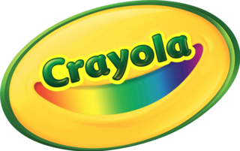
Get Ready to go Back to School
Bobbie Adelson, Kendra Folks, Valerie Conolly, and Zakareya Alsaleh
3/10/22

Slide 2
Why We are Here
Problem Statement
The world is currently still suffering through a pandemic which is resulting in schools continually becoming virtual, this is a potential obstacle for Crayola who sells creative art supplies for kids to use in class and could result in a decrease in sales.
To address this issue and achieve our goal…
To promote Crayola’s new product line “Colors of the World” during the back-to-school season to teachers and students by measuring the sales of the products in the line.
To increase media relations to our target audiences of teachers before the back-to-school season and measure media engagement.
To increase awareness for Crayola brand products and create partnerships with nonprofits for shared marketing and information for sales and other periods of Crayola outreach programs

Slide 3
Situation analysis

Slide 4
PEST Analysis
Social Factors:
Racial equity
Climate change
Sustainability issues
Technological Factors:
Advancements in technology
Changes in desire/want
Decreased desire for products
Increased desire for technology
Political Environment Factors:
COVID-19
Mask mandates
Vaccine mandates
Russia/Ukraine
Economic Factors:
Inflation rate
Gross Domestic Product (GDP) rate

Slide 5
SWOT Analysis
STRENGTHS
Established brand recognition
Consistent social media engagement/following
Crayola mobile applications
Variety of art supplies and products sold in 80+ countries
High employment rate
WEAKNESSES
Focus lies on production and sales
Heavy focus on crayons
Expensive product line
Lacking brand recognition
YouTube
S
W
Brand collaborations
Curating to digital art
Donations to underprivileged schools
Sustainability
DEI
Established customer loyalty
OPPORTUNITIES
Remote learning threatens in person learning
Pandemic leading to financial issues and no use for sharing art supplies
Digital art
Competition with other brands oneline and/orcheaper
THREATS
O
T

Slide 6
Target Audience Profiles

Slide 7
Homeschool Mothers
Crosses socioeconomic boundaries, but shares many economic and psychographic needs.
Prior to COVID the community was largely white, with higher economic status
Pandemic related school closures changed the audience, though this change was temporary
The audience is largely educated, with higher educational brackets being prominent
Needs focused upon educating their children, but also considerations for economic issues
Targeting the audience with focus on creative expression, educational benefits and low-cost opportunities.

Slide 8
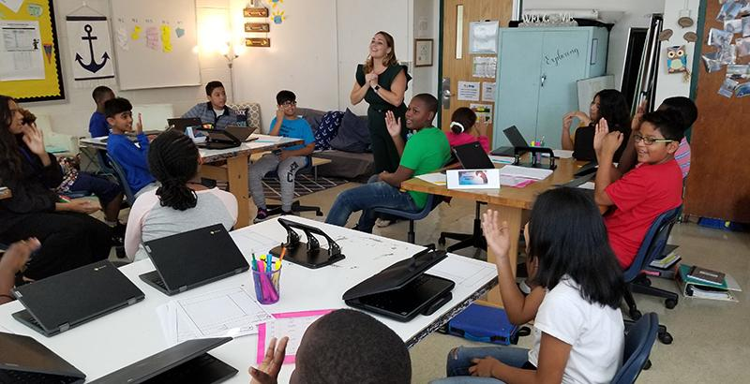
Teachers in Low-income communities
Major concerns are about economic capabilities, especially with limited school funding and restricted parental support
Audience psychographic goals are first education, with an added focus on creative expression. Additionally, the audience considers economic factors due to the nature of low-income communities
Often times reliant on their own income to purchase classroom supplies, meaning the audience is highly conscience of material costs
Demographically diverse, though statistically more likely that the audience will have a higher minority percentage than seen in other teaching demographics.
Targeting this audience should highlight educational opportunities and low-cost products that meet shared needs

Slide 9
Youth (Age 10-15)
Audience is often influenced by peer perception
Branding and status are key elements when addressing this audience based upon peer perception
Demographically dispersed across all socioeconomic categories
Unemployed and currently being educated
Influential on other audiences due to their relationship as children in the schools and through influencing parents

Slide 10
Strategic Recommendations

Slide 11
Proposed goals and objectives + key messages
Goal: The goal for Crayola is to increase sales for the 2022 back-to-school season and to inspire and educate children, teachers, and parents about the values of diversity and equality.
Objectives:
To promote Crayola’s new product line “Colors of the World” during the back-to-school season to teachers and students by measuring the sales of the products in the line and elaborating a social media campaign around the Colors of the World to emphasize diversity, equity, and inclusion for Crayola as a brand.
To increase media relations to our target audiences of teachers, parents, and students before the back-to-school season and measure media engagement and creating a platform for teachers to post how their student’s art using Crayola’s products and allow teachers to share ideas and highlight creativity in the classroom.
To increase awareness for Crayola brand products and create partnerships with nonprofits for shared marketing and information for sales and other periods of Crayola outreach programs.
Mission Statement:
“Our mission is to help parents and educators raise creatively-alive children. We want to help kids ask those “what if?” questions that keep them curious. So, our goal is to free the “What If?” questions in kids' minds.”

Slide 12
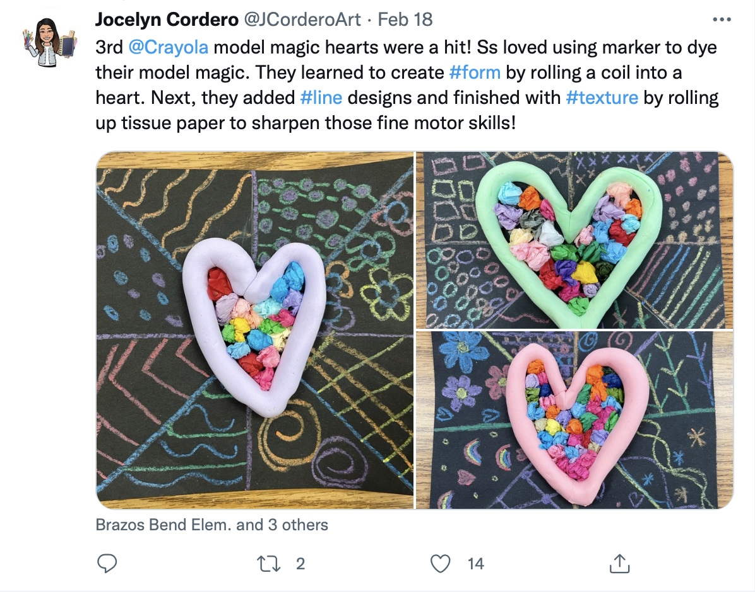
Proposed goals and objectives + key messages
Primary Message: Crayola wants kids of all ages to ignite their creativity by coloring outside the lines and to always play, pretend, dream, discover, and explore.
Secondary Messages:
Creating a platform for teachers to post their student’s art using Crayola’s products and allow teachers to share ideas and highlight creativity in the classroom
Proof points: Teacher-oriented platform instead of Crayola’s social media platforms which are targeted to all their audiences.

Slide 13
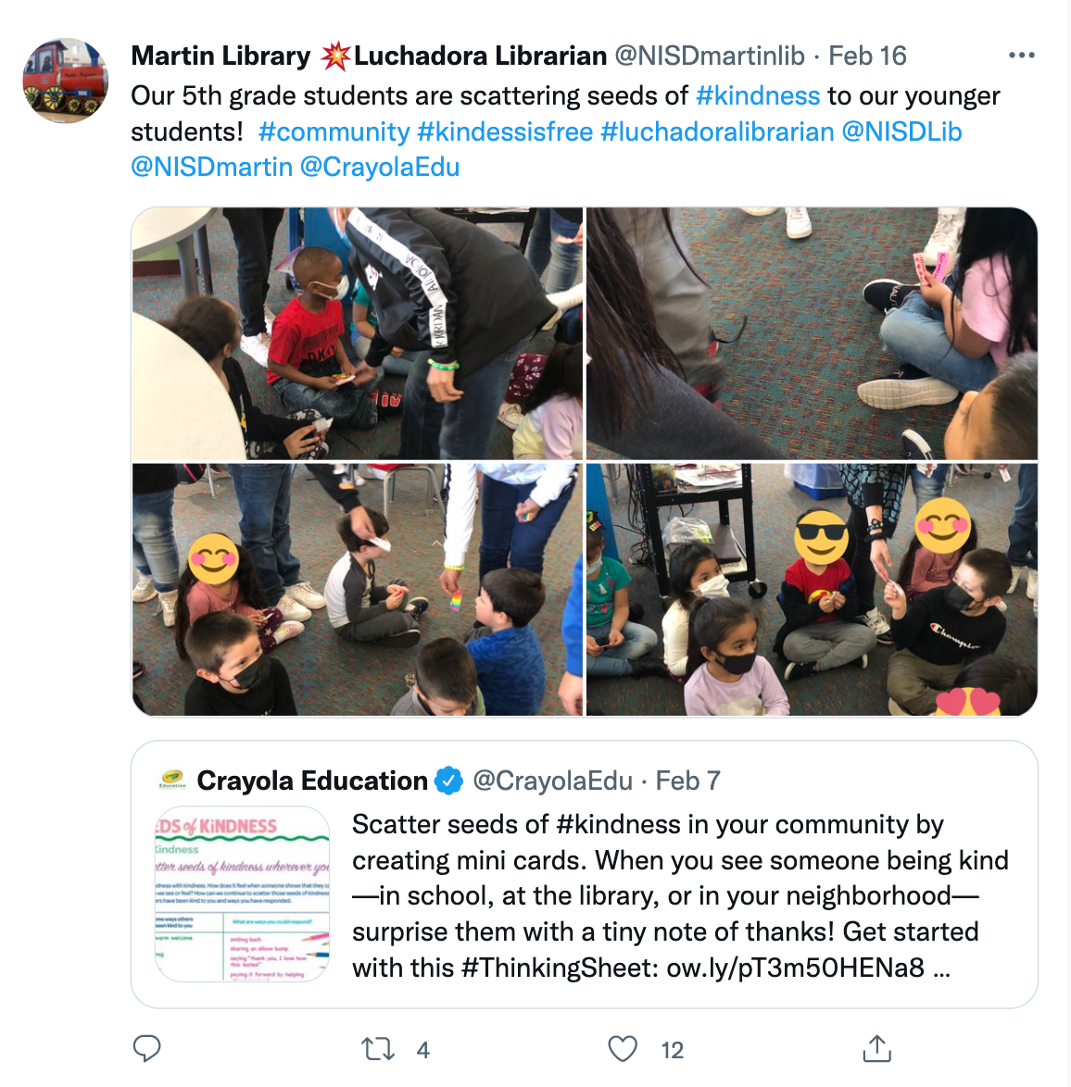
Proposed goals and objectives + key messages
Secondary Messages:
2. Inviting Crayola-users to connect with the Crayola platform in educational interactive activities allows students to utilize their creativity and explore their thoughts in action.
Proof points: @Crayolaedu in place of @Crayola to focus on the educational aspects that the organization brings and allows for its audience to gain educational concepts/understandings.

Slide 14
Strategies + tactics
Strategy 1: To promote Crayola’s new product line “Colors of the World” during the back-to-school season to teachers and students by measuring the sales in the line. To accomplish the objective, we recommend a media relations strategy focused on our target audiences, teachers, parents, and students during the back-to-school season. This strategy will allow us to increase awareness for Crayola and encourage more sales.
Tactics
Newsletter
PR packages to parent/teacher bloggers, influencers
Posting on all of Crayola’s social media accounts.

Slide 15
Strategies + tactics
Strategy 2: To increase media relations to our target audiences of teachers, parents, and students before the back-to-school season. Creating a platform for teachers to post how their student’s art using Crayola’s products and allow teachers to share ideas and highlight creativity in the classroom.
Tactics
Creating a free admission event for teachers, parents, and students at Crayola Experience locations.
Press release after the event summarizing the event and the announcement at the event.
Launching the platform on the Crayola website.

Slide 16
Strategies + tactics
Strategy 3: We will encourage online sales by donating a portion of all online sales to education nonprofits or by equally donating the same product of a whole week before the school year starts. To accomplish the objective, we recommend implementing a media campaign strategy on all Crayola media platforms. This strategy will allow us to measure metrics, data, and engagement rates.
Tactics
Add graphics for Crayola website.
Running TV and Social Media Ads.
Crayola social media takeover for 5 days of the non-profits we will donate to (Jumpstart, Room to Read, New Teacher Project, Education Trust, Learning Forward)

Slide 17
Implementation Logistics

Slide 18
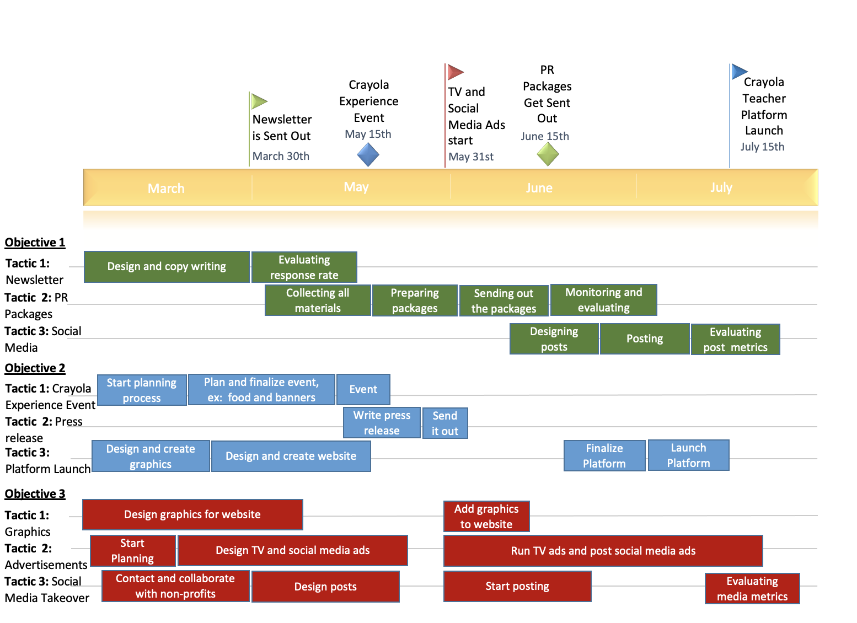
Schedule

Slide 19
Budget
 | Costs | Total Costs
Objective 1:
Tactic 1: | $1,100
Tactic 2: | $4,242
Tactic 3: | $29,350
 |  | $34,692
Objective 2:
Tactic 1: | $9,500
Tactic 2: | $1,212.50
Tactic 3: | $4,800
 |  | $15,512.50
Objective 3:
Tactic 1: | $2,500
Tactic 2: | $111,350
Tactic 3: | $11,600
 |  | $125,450
 |  | $175,654.50

Slide 20
Evaluation Plan

Slide 21
Objective 1
To promote Crayola’s new product line “Colors of the World” during the back-to-school season to teachers and students by measuring the sales of the products in the line and elaborating a social media campaign around the Colors of the World to emphasize diversity, equity, and inclusion for Crayola as a brand.
Goal: The goal of this objective is to promote the “Colors of the World” product line by utilizing newsletters, PR packages and social media. These tactics will aid in the promotion of “Colors of the World” which will be measured through sales.
Method for Evaluation:
Specific: This objective focuses especially on the back-to-school season and promoting the new product line.
Measurable: Measuring sales of the “Colors of the World” product line through online sales, and in-person stores.
Attainable: Teachers and parents purchase most products for their kids either in an online or in-person setting.
Relevant: The sales of the product will constitute how well Crayola will do during the back-to-school season.
Time-bound: Before and during the back-to-school season.

Slide 22
Objective 2
To increase media relations to our target audiences of teachers, parents, and students before the back-to-school season and measure media engagement and creating a platform for teachers to post how their student’s art using Crayola’s products and allow teachers to share ideas and highlight creativity in the classroom.
Goal: The goal of this objective is to increase media relations by promoting a Crayola Experience event, reaching out to the press to conduct press releases and create a Crayola platform launch. These tactics will aid in increased engagement which will be measured through media platform analytics.
Method for Evaluation:
Specific: By targeting our target audiences makes this objective specific and allows the tactics to be even more specific with media relations.
Measurable: Measuring media engagement on different media platforms used during the objective. The metrics coils include new followers, views, or new account engagement.
Attainable: Teachers and parents find most of their new products for kids via Facebook, Instagram, and TikTok. By seeing Crayola’s targeted ads, teachers/parents will be more inclined to purchase.
Relevant: Since this can be measured and specific to everything Crayola needs to obtain its main goal of increasing sales this objective is super relevant.
Time-bound: Before and during the back-to-school season.

Slide 23
Objective 3
To increase awareness for Crayola brand products and create partnerships with nonprofits for shared marketing and information for sales and other periods of Crayola outreach programs.
Goal: To increase affordability and all-around awareness of Crayola’s products in stores where it is sold.
Method for Evaluation:
Specific: The target audiences are most focused on the cost for Crayola products, so raising awareness of affordability creates a specific objective for the public relations campaign. Creating partnerships with major retailers provides Crayola the opportunity to engage wider audiences within the target markets by capturing those consumers that may not be reached through direct public relations statements from the company.
Measurable: Two specific metrics can be used within the third objective. The first metric will be the number of social media likes, responses, and similar activity from the consumer based upon active posts in the campaign. The second metric will be the number of partnerships Crayola develops with major retailers to expand the shared messaging about affordability for Crayola products.
Attainable: Increasing public understanding of the pricing opportunities for Crayola products makes the brand more approachable to the target audiences. The objective is therefore attainable as it relates to clear messaging tactics along with partnerships with existing retail companies, something that is often utilized both in marketing and public relation campaigns.
Relevant: The current issue facing Crayola is the loss of sales within the target audiences. By developing better awareness about the brand, partly through shared information with retailers utilizing discount programs along with knowledge of the “Colors of the World” campaign, the company will build a better knowledge base in the target audience. As the shared goals of increasing sales with other retail companies would help meet the fundamental issue for Crayola, this objective would be highly relevant to meeting the company’s needs.
Time-Bound: Given the rapid deployment of social media and digital messaging, along with partnerships that build their own messaging, the timeline for completion would be done within a three-month period leading to the back-to-school time in summer 2022.

Slide 24
Summary
The back-to-school season in 2022 is still unknown. Classes could still be virtual or classes could still be impacted. With our plan, we hope to help Crayola keep its sales up during the crucial back-to-school season.

